Slide 1

Project Title : Restaurant Analysis of Swiggy
Domain : FOOD DELIVERY SERVICE
By
Suvashini S

Slide 2
Agenda
Introduction
Objectives
Data Overview
Analysis
Visualizations
Recommendations
Conclusion

Slide 3
Introduction
Overview: Swiggy has revolutionized the food delivery landscape in India, connecting millions of consumers with a vast array of dining options. As one of the leading platforms in the industry, Swiggy’s success hinges on its ability to understand and respond to customer preferences and market trends.
Project Purpose: This project focuses on analyzing restaurant data from Swiggy to uncover insights that can enhance business strategies and improve customer satisfaction. By examining key metrics such as restaurant ratings, delivery times, and popular cuisines, we aim to provide actionable recommendations for optimizing operations and enriching the dining experience.
Significance: In today’s competitive food delivery market, understanding consumer behavior and operational efficiencies is crucial. This analysis will empower Swiggy to:
Adapt to evolving consumer tastes.
Streamline delivery processes for better service.
Maintain a competitive edge through data-driven insights.

Slide 4
Objectives
Identify Customer Preferences
Determine Popular Cuisines
Evaluate Top-Rated Restaurants
Analyze Delivery Performance
Explore Correlations
Provide Actionable Recommendations

Slide 5
Data Overview
Dataset Description:
The analysis is based on a comprehensive dataset containing restaurant information sourced from Swiggy. This dataset captures various attributes that are critical for understanding restaurant performance and customer preferences.
Key Variables:
ID:A unique identifier for each restaurant to ensure distinct tracking.
Area:The neighborhood where the restaurant is located, helping to analyze regional dining preferences.
City:The city of operation, allowing for comparisons between different urban areas.
Restaurant:The name of the restaurant, serving as a direct reference for analysis.
Price:The average dining cost at the restaurant, essential for evaluating pricing strategies.

Slide 6
Avg Ratings:The average customer rating, reflecting the quality of food and service.
Total Ratings:The cumulative number of ratings received, indicating the restaurant's popularity.
Food Type:Categories of cuisines offered, vital for understanding customer preferences.
Address:The complete location of the restaurant, useful for geographic analysis.
Delivery Time:The average time for food delivery, critical for assessing operational efficiency
Purpose of the Data:
This dataset is utilized to derive insights into customer preferences, restaurant performance, and operational efficiencies. The analysis aims to identify trends, correlations, and opportunities for improvement that can inform strategic business decisions.

Slide 7
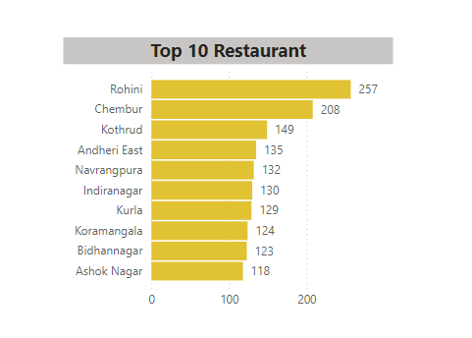
Analysis
Task 1: Top 10 Areas with Most Restaurants

Slide 8
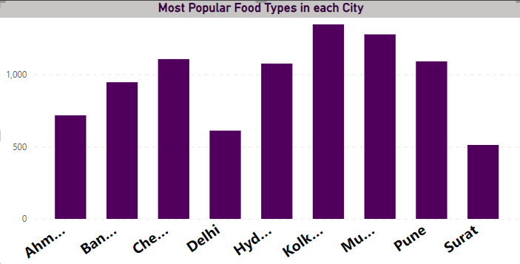
Task 2: Most Popular Food Types Served by Swiggy Restaurants in Each City.

Slide 9
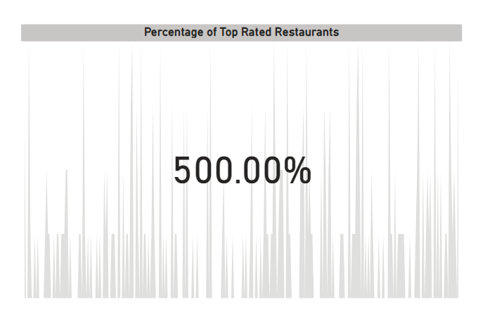
Task 3: Top Rated Swiggy Restaurants (In Percentage average rating above 4.5)

Slide 10
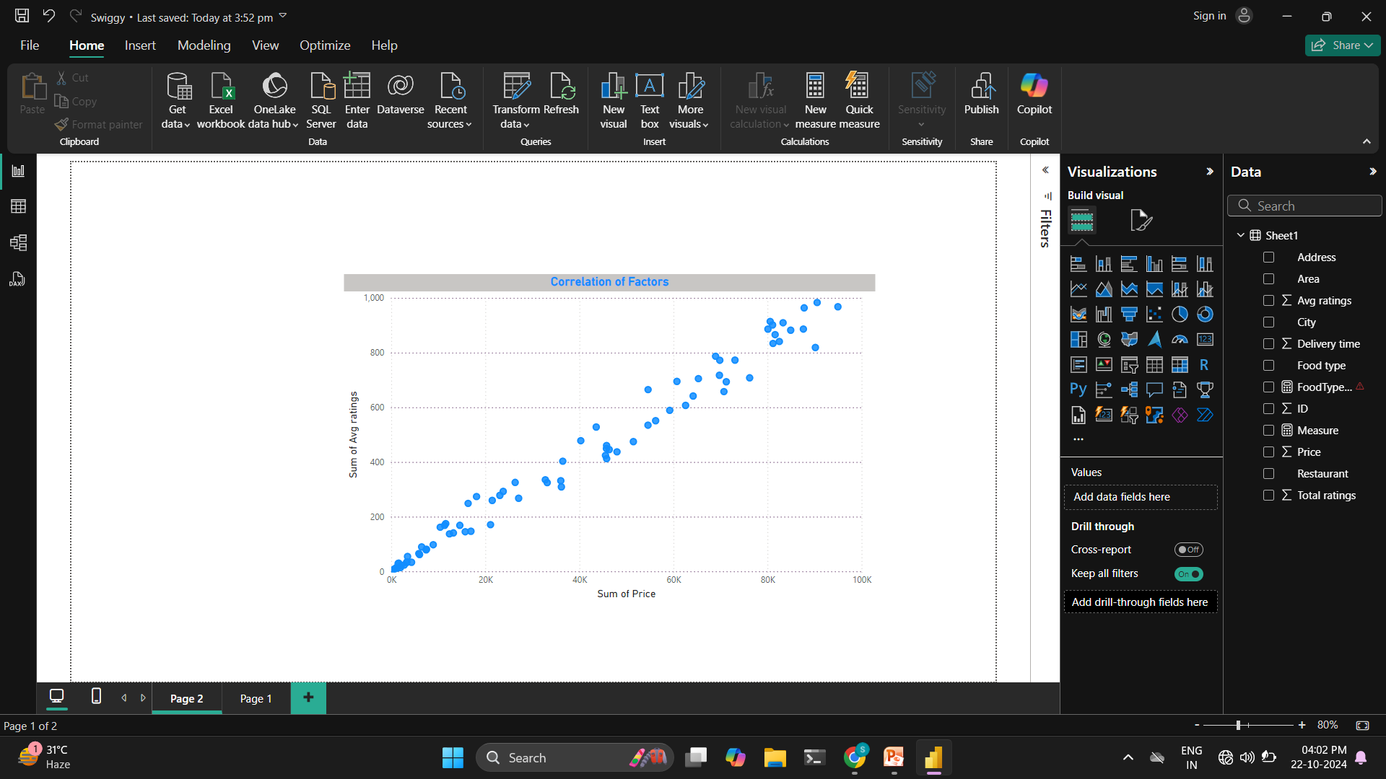
Task 4: Correlation of Factors Affecting Average Rating

Slide 11
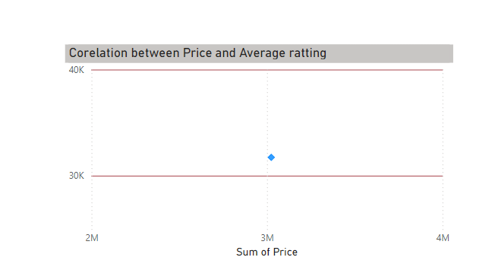
Task 5: Correlation Between Restaurant Price and Average Rating

Slide 12
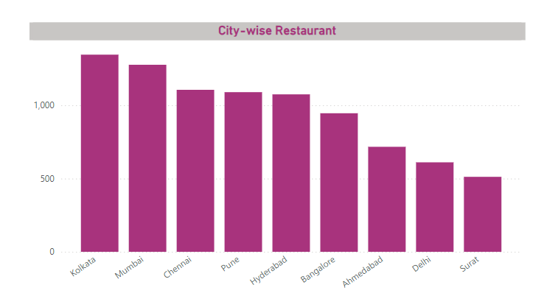
Task 6: City-wise Restaurant Count

Slide 13
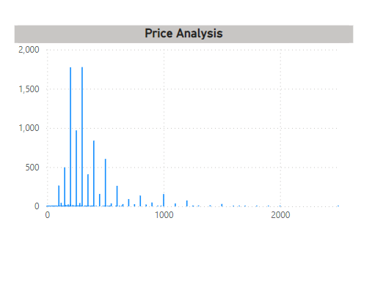
Task 7: Price Analysis

Slide 14
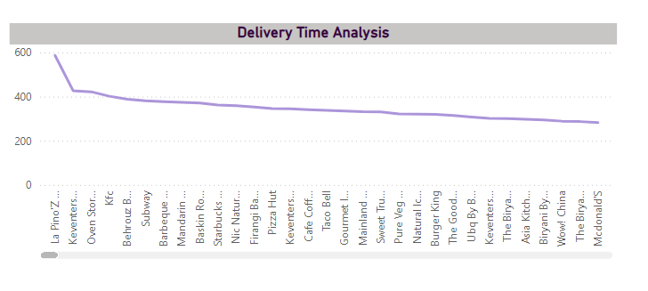
Task 8: Delivery Time Analysis

Slide 15
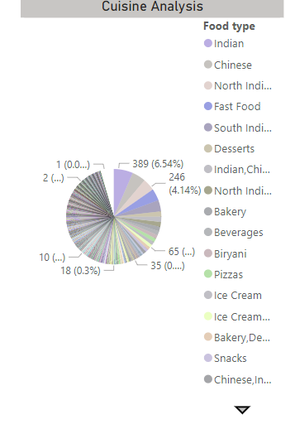
Task 9: Cuisine Analysis

Slide 16
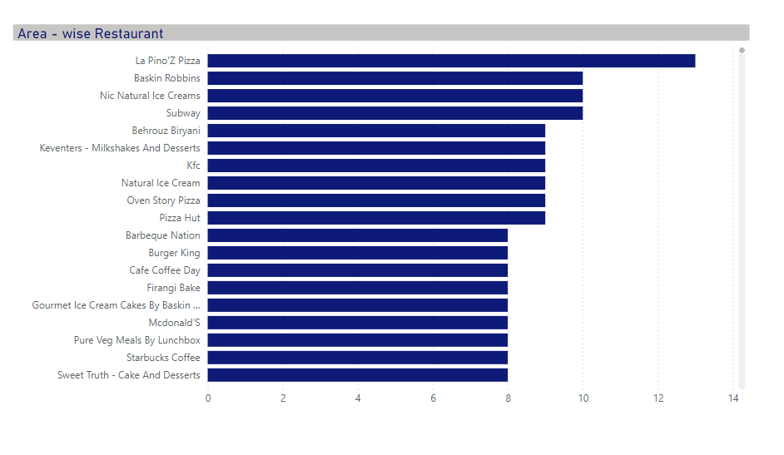
Task10: Area-wise Restaurant Analysis

Slide 17
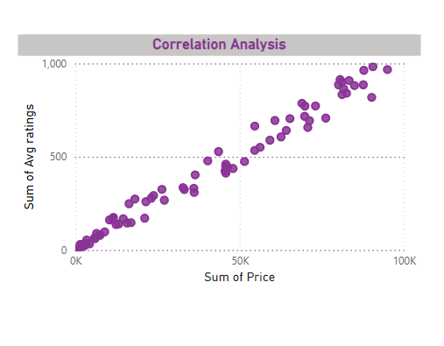
Task 11: Correlation Analysis

Slide 18
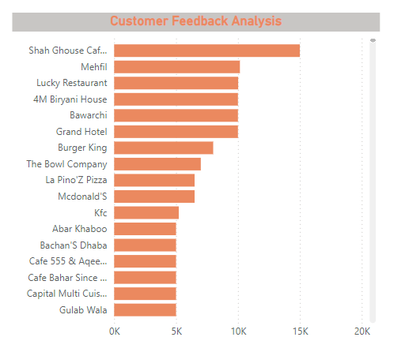
Task 12: Customer Feedback Analysis

Slide 19

Task 13: Geographical Mapping

Slide 20
Task 14: Business Recommendation
Optimize Delivery Operations `
Real-Time Tracking
Predictive Analytics for Delivery Times
Dynamic Menu Management:
Seasonal and Local Specials
Customer Feedback Loop
Targeted Marketing Campaigns
Geo-Targeting Promotions
Behavior-Based Offers
Enhance User Experience on the App:
Simplified Navigation
Incorporate User Reviews

Slide 21
Collaborative Partnerships
Local Restaurant Collaborations
Food Trucks and Pop-Ups
Sustainability Initiatives
Eco-Friendly Packaging
Waste Reduction
Data-Driven Decision Making
Regular Analytics Reviews
Competitor Benchmarking

Slide 22
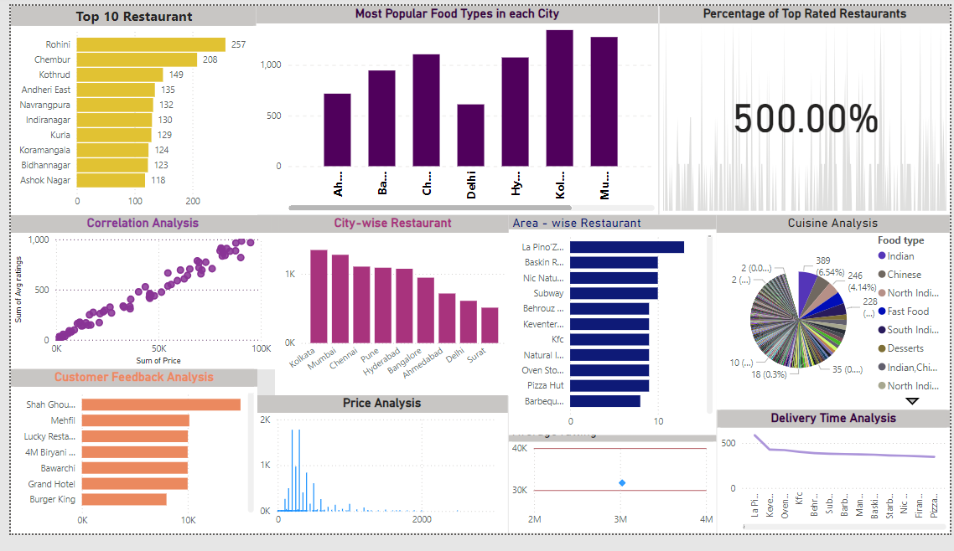
Visualizations
Restaurant analysis of swiggy dashboard

Slide 23
Strategic Recommendations
Improve Delivery Logistics: Focus on areas with longer delivery times to boost ratings and customer retention.
Tailor Offerings: Adjust menu items based on regional preferences to align with customer demands.
Promote High Ratings: Utilize the visibility of top-rated restaurants to attract more customers and enhance market positioning.

Slide 24
Conclusion
It provided valuable insights into restaurant performance and customer preferences within the food delivery sector. Key findings highlighted the importance of optimizing delivery logistics, tailoring menu offerings to local tastes, and leveraging high-rated restaurants in marketing efforts. These insights enable strategic decision-making that can enhance customer satisfaction, improve operational efficiency, and identify new market opportunities, ultimately driving growth in a competitive landscape.

Slide 25
Thank you

